Slide 1
Digital Electronics Crash course – day 2
23-AUG-2018
Abhimanyu Arora
Koh Yi Min Jason

Slide 2
Table of content
Day 1 1) Binary/Hexadecimal/BCD
2) Signed/Unsigned number
3) Binary and Hexadecimal addition
4) Logic gates circuits and Boolean Algebra
5) Implementing/simplifying logics gates
6) SOP (Sum-Over-Product), POS (Product-Over-Sum) and K-map
Day 2
7) Clock Signal and flip-flops (SR, JK, T, D)
8) D flip-flop state machine
9) Multiplexer, Comparator and De-Multiplexer
10) Encoder, Decoder, decade counter, up/down synchronous counter and ripper counters
11) 7-Segment display, 7-Segment display decade counter and BCD to 7-segment display driver

Slide 3
Clock Signal and flip-flops (RS, JK, T, D)

Slide 4
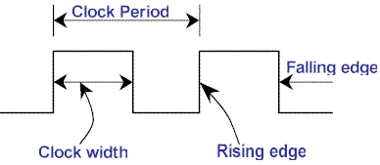
Clock Signal
Clock Signal A clock signal are signal that oscillates between a high and a low state. It is use to “tell” the electronic device that it is time to change state
Electronic devices will change state either on the Rising Edge or Falling Edge of the Clock pulse
The shorter the Clock period (faster frequency), the faster the device will change state

Slide 5
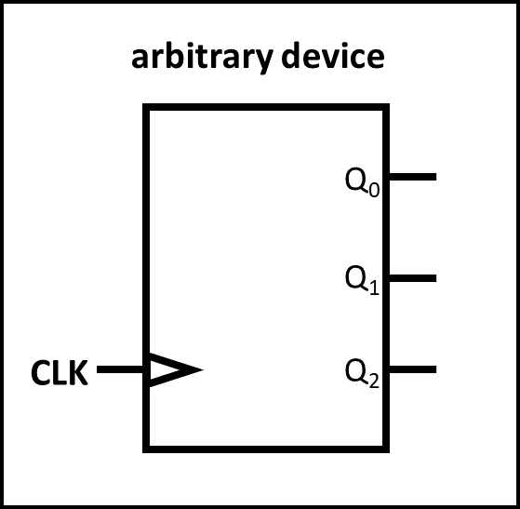
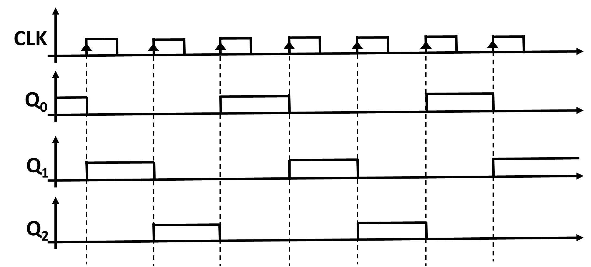
Clock SIGNAL
Rising Edge trigged device
Below shows an arbitrary device that reacts to the Rising Edge of the clock pulse.
The device alters from Q₀ to Q₁ to Q₂ and back to Q₀ again when there is an Rising Edge clock pulse

Slide 6
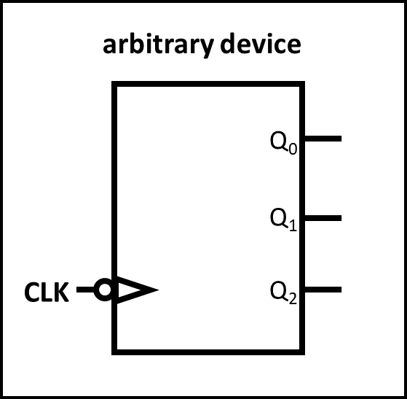
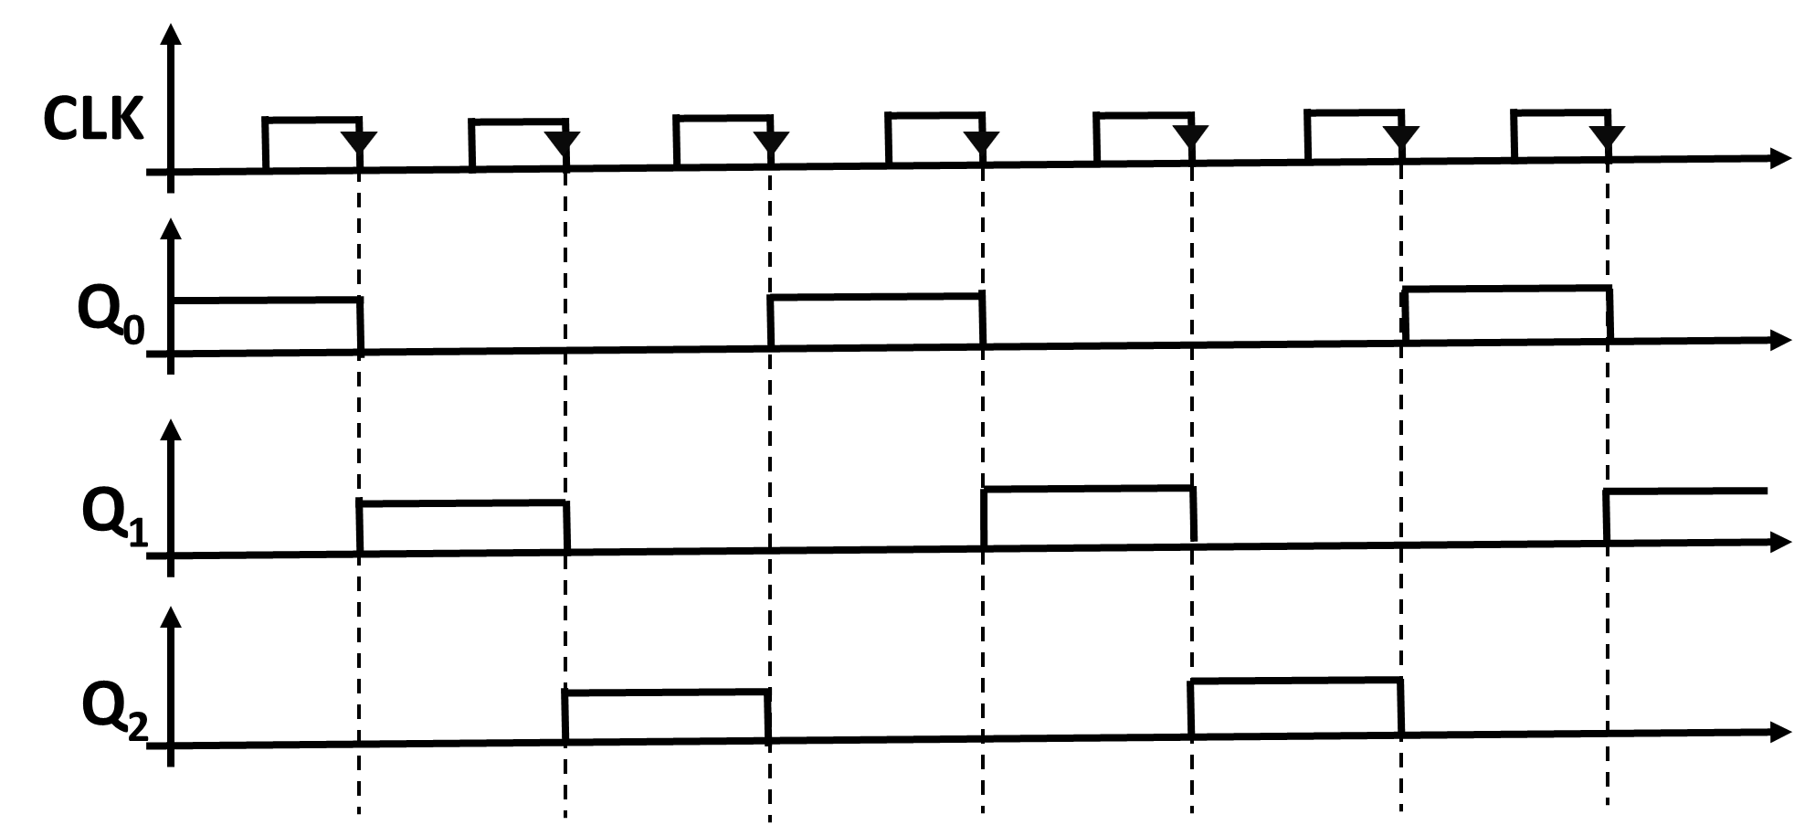
Clock SIGNAL
Falling Edge trigged device
Below shows an arbitrary device that reacts to the Falling Edge of the clock pulse.
The device alters from Q₀ to Q₁ to Q₂ and back to Q₀ again when there is an Falling Edge clock pulse

Slide 7
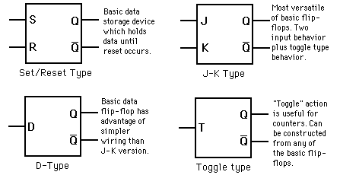
Flip-flop
What are flip-flops A flip-flop is a latch circuit that has two stable states. Flip-flops can be used to store state information. There are 4 common flip-flops
(SR, JK ,D ,T)

Slide 8
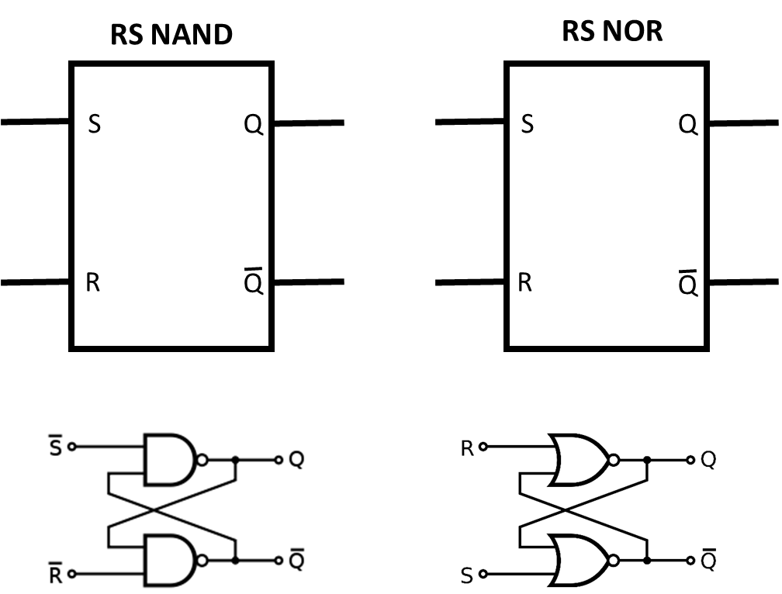
Flip-flop
SR Flip-Flop
SR NAND Truth Table
S | R | Q | Q’
0 | 0 | undefined | undefined
0 | 1 | 1 | 0
1 | 0 | 0 | 1
1 | 1 | No change | No change
SR NOR Truth Table
S | R | Q | Q’
0 | 0 | No change | No change
0 | 1 | 0 | 1
1 | 0 | 1 | 0
1 | 1 | undefined | undefined

Slide 9
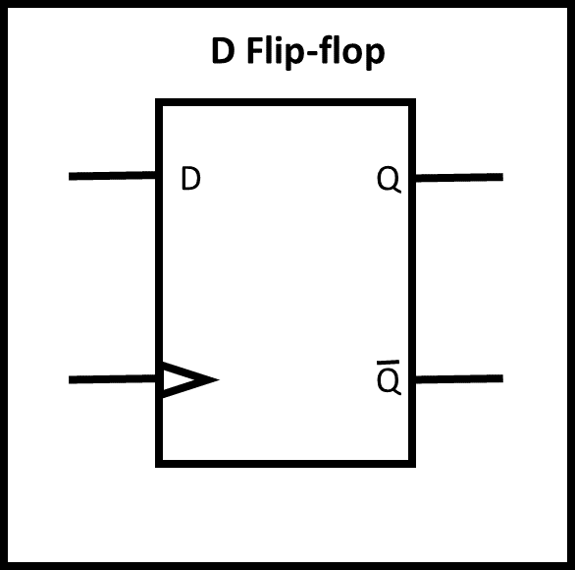
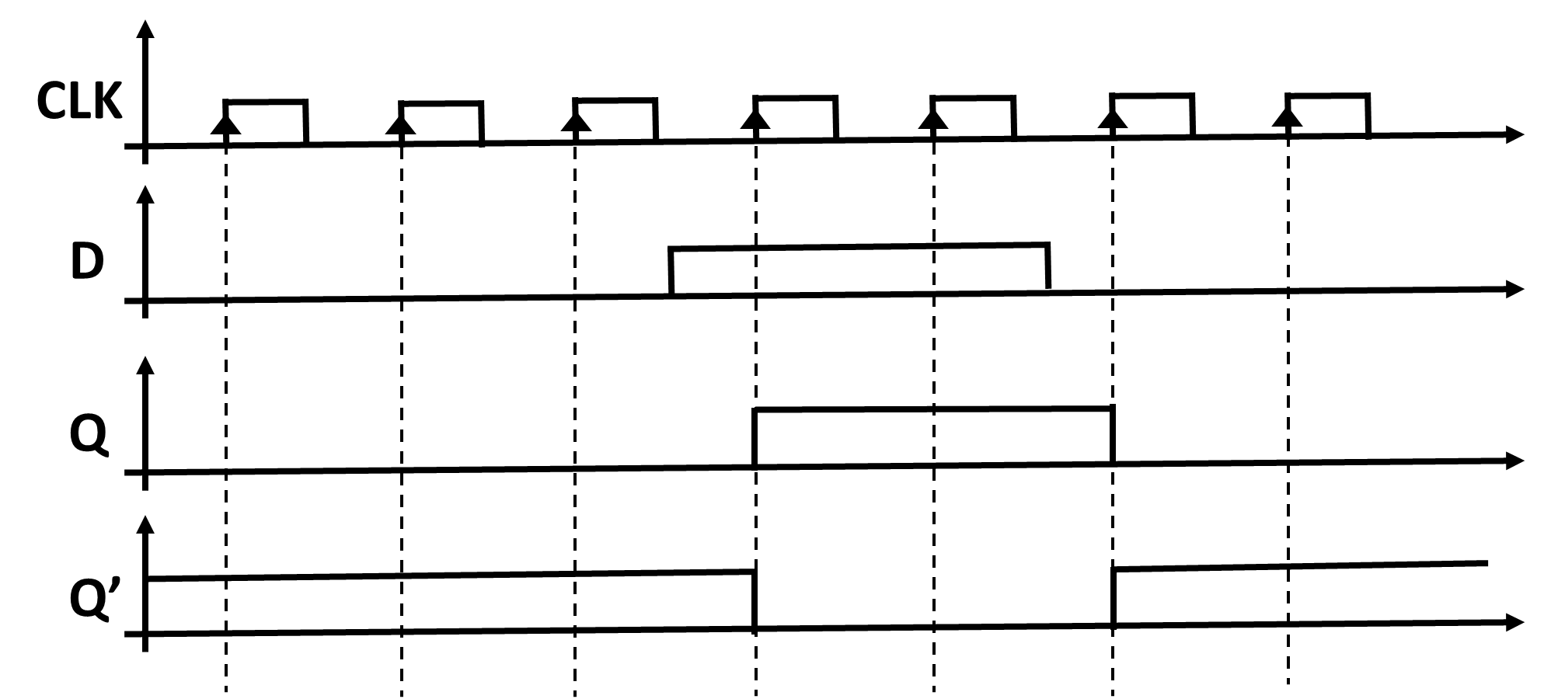
Flip-flop
D Flip-Flop
When the D input is LOW, on the next rising edge, Q will be LOW When the D input Is HIGH, on the next rising edge, Q will be The Q’ output is compliment to the Q output

Slide 10
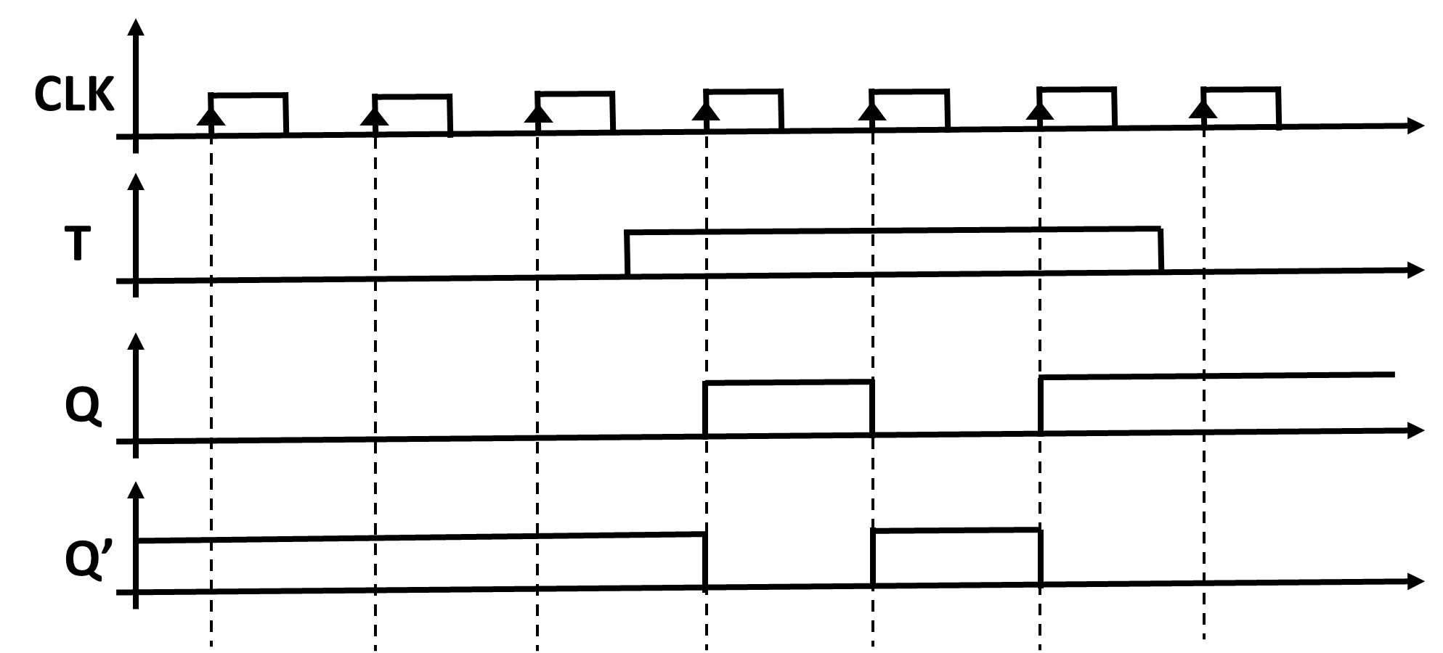
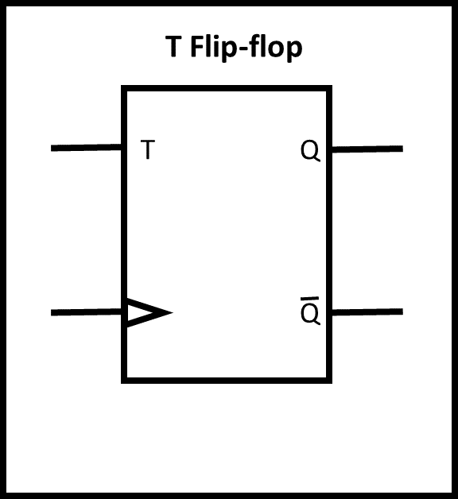
Flip-flop
T Flip-Flop
When the T input is HIGH, Q will toggle from LOW to HIGH and HIGH to LOW on each rising edge of the clock pulse. When the D input Is LOW, there is no toggle and Q will remain LOW or HIGH depending on the state the T input is set to LOW before the next rising edge Q’ Output is compliment to Q Output

Slide 11
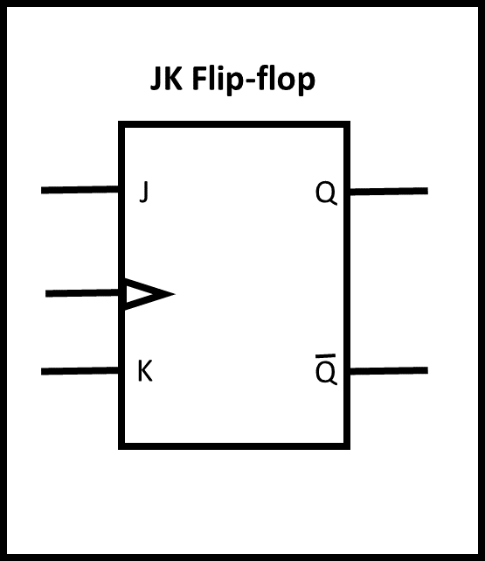
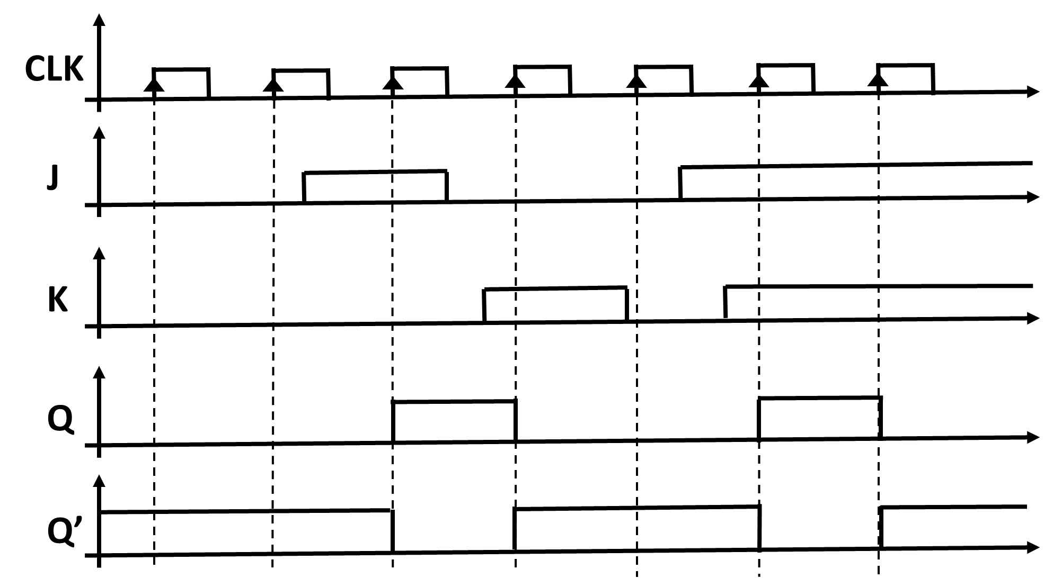
Flip-flop
JK Flip-Flop
When J is LOW and K is LOW, Q will not change state
When J is HIGH and K is LOW, Q will always remain HIGH
When J is LOW and K is HIGH, Q will always be LOW
When J is HIGH and K is HIGH, Q will toggle between HIGH and LOW on every rising edge of the clock pulse Q’ Output is compliment to Q Output

Slide 12
D flip-flop state machine

Slide 13
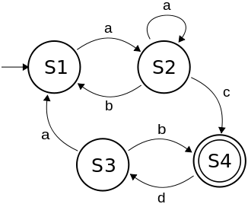
D flip-flop state machine
D flip-flops can be connected with logic gates to create a state machine What is a State Machine? A state machine is an electronic circuit that will change it states depending on the input it receives A state diagram of a state machine is shown on the right

Slide 14
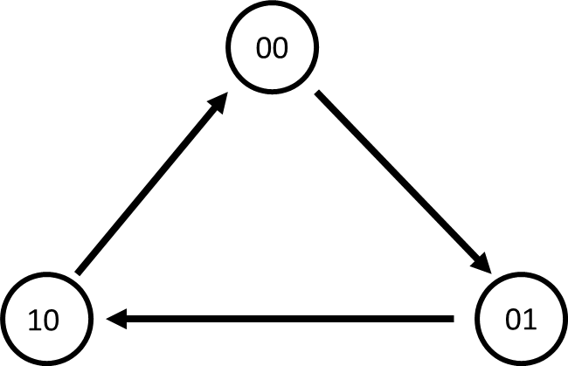
D flip-flop state machine
Example 1:
Create a state-machine that changes from 00 to 01 to 10 and back to 00 again using 2 D flip-flops

Slide 15
D flip-flop state machine
Step 1 Write down all the present states
Present state |  | Next State |  | D inputs
Q₁ | Q₀ | Q₁ | Q₀ | D₁ | D₀
0 | 0
0 | 1
1 | 0

Slide 16
D flip-flop state machine
Step 2 Write down all the next states
Present state |  | Next State |  | D inputs
Q₁ | Q₀ | Q₁ | Q₀ | D₁ | D₀
0 | 0 | 0 | 1
0 | 1 | 1 | 0
1 | 0 | 0 | 0

Slide 17
D flip-flop state machine
Step 3 From the D Flip-flop state truth table, fill up the corresponding D inputs
Present state |  | Next State |  | D inputs
Q₁ | Q₀ | Q₁ | Q₀ | D₁ | D₀
0 | 0 | 0 | 1 | 0 | 1
0 | 1 | 1 | 0 | 1 | 0
1 | 0 | 0 | 0 | 0 | 0
D flip-flop state truth table
Q_{n} | Q_{n+1} | D
0 | 0 | 0
0 | 1 | 1
1 | 0 | 0
1 | 1 | 1

Slide 18
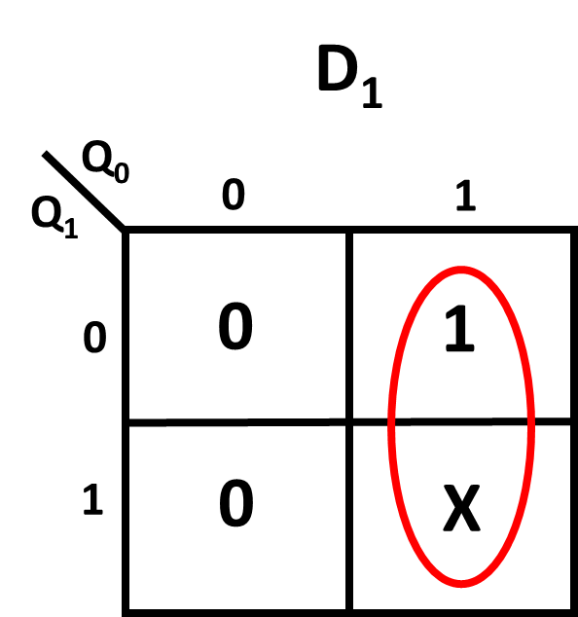
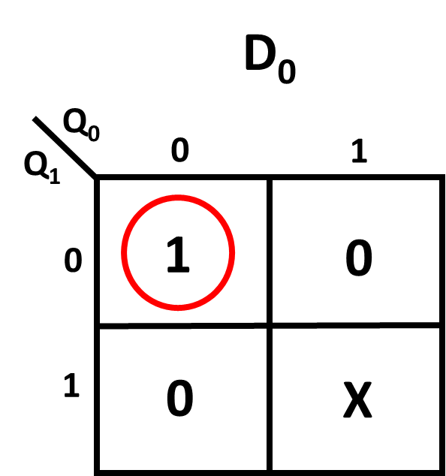


D flip-flop state machine
Step 4 Create 2 K-map for D₁ and D₀ whose inputs are the present states of Q₁ and Q₀
Table we had created
Present state |  | Next State |  | D inputs
Q₁ | Q₀ | Q₁ | Q₀ | D₁ | D₀
0 | 0 | 0 | 1 | 0 | 1
0 | 1 | 1 | 0 | 1 | 0
1 | 0 | 0 | 0 | 0 | 0
D₁ = $Q$₀
D₀ = $\overline{Q}0\overline{Q}$₁

Slide 19
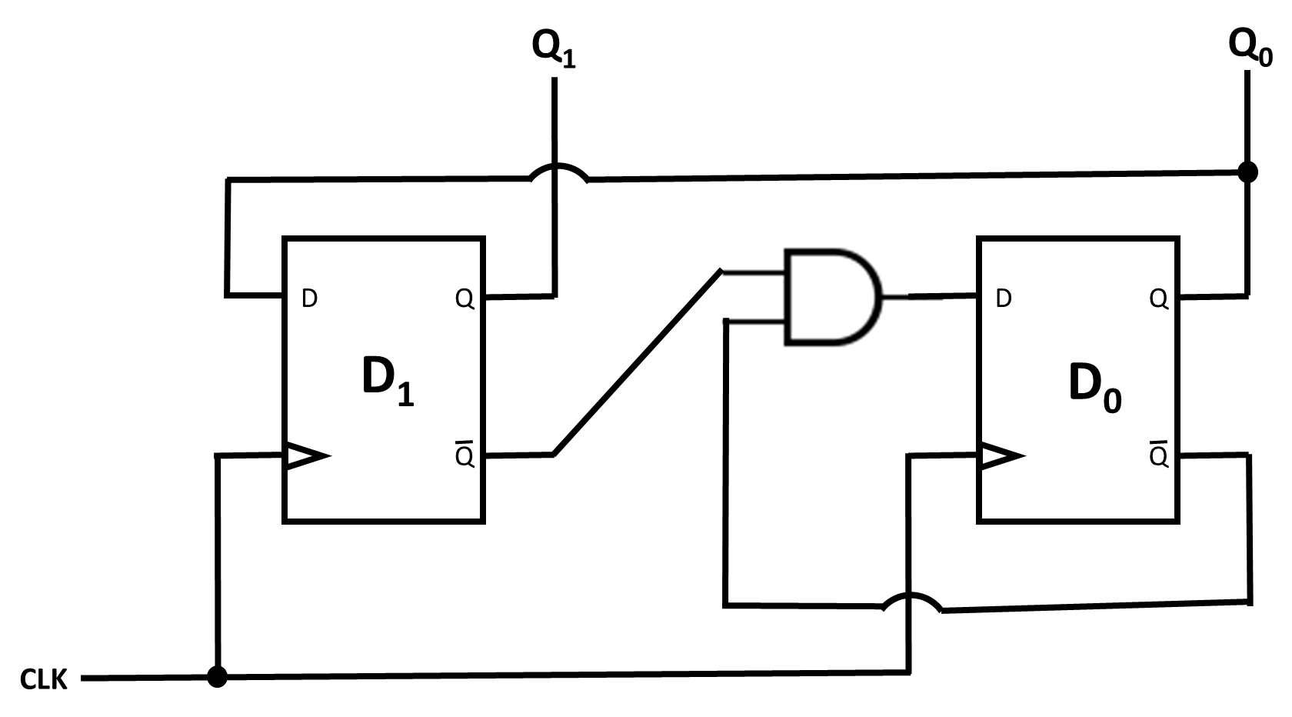


D flip-flop state machine
Step 5 Implement the circuit
D₁ = $Q$₀
D₀ = $\overline{Q}0\overline{Q}$₁

Slide 20
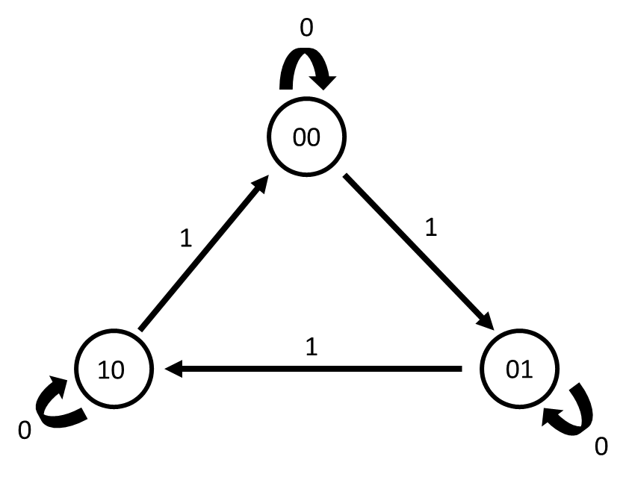
D flip-flop state machine
Example 2: Create a state-machine that changes from 00 to 01 to 10 and back to 00 again using 2 D flip-flops only when its input x is TRUE.

Slide 21
D flip-flop state machine
Do step 1, step 2 and step 3 as mentioned above in Example 1
Present state |  |  | Next State |  | D inputs
Q₁ | Q₀ | X | Q₁ | Q₀ | D₁ | D₀
0 | 0 | 0 | 0 | 0 | 0 | 0
0 | 0 | 1 | 0 | 1 | 0 | 1
0 | 1 | 0 | 0 | 1 | 0 | 1
0 | 1 | 1 | 1 | 0 | 1 | 0
1 | 0 | 0 | 1 | 0 | 1 | 0
1 | 0 | 1 | 0 | 0 | 0 | 0

Slide 22
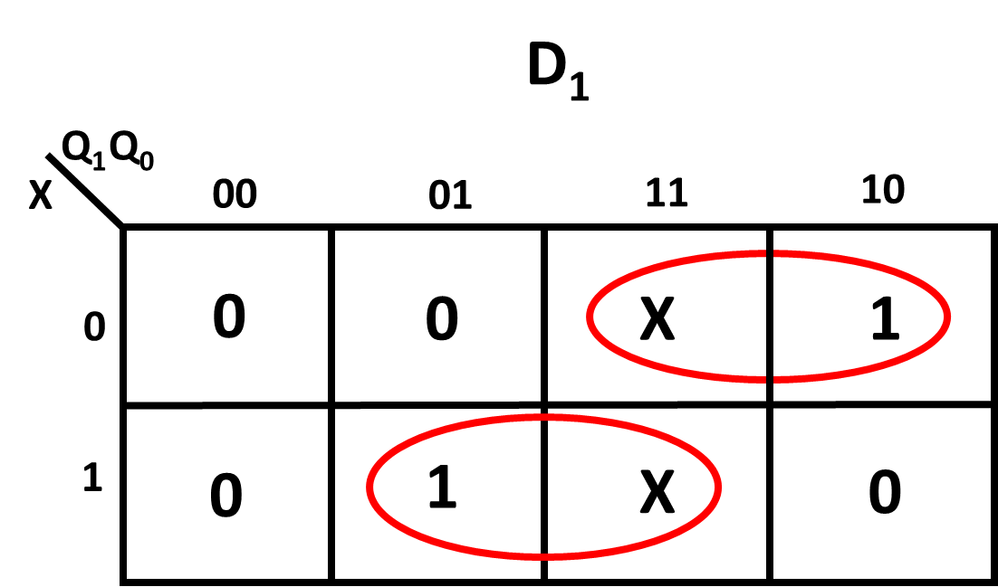
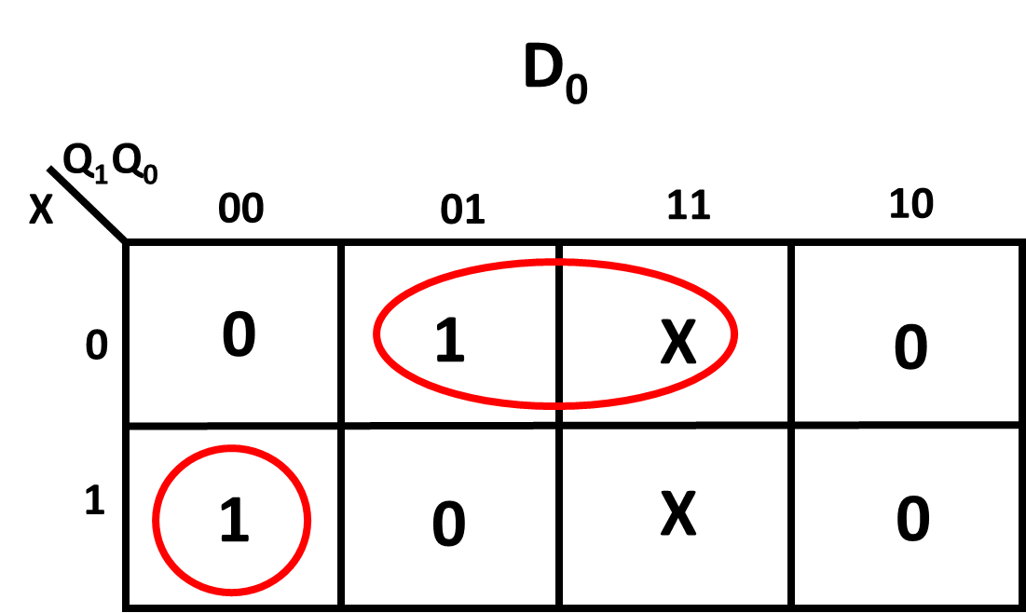


D flip-flop state machine
Step 4 Create 2 K-map for D₁ and D₀ whose inputs are the present states of Q₁ and Q₀ together with input X
Table we had created
Present state |  |  | Next State |  | D inputs
Q₁ | Q₀ | X | Q₁ | Q₀ | D₁ | D₀
0 | 0 | 0 | 0 | 0 | 0 | 0
0 | 0 | 1 | 0 | 1 | 0 | 1
0 | 1 | 0 | 0 | 1 | 0 | 1
0 | 1 | 1 | 1 | 0 | 1 | 0
1 | 0 | 0 | 1 | 0 | 1 | 0
1 | 0 | 1 | 0 | 0 | 0 | 0
$D$₁ = Q₀X + Q₁$\overline{X}$
$D$₀ = Q₀$\overline{X}$ + $\overline{Q}$₁$\overline{Q}$₀ X

Slide 23
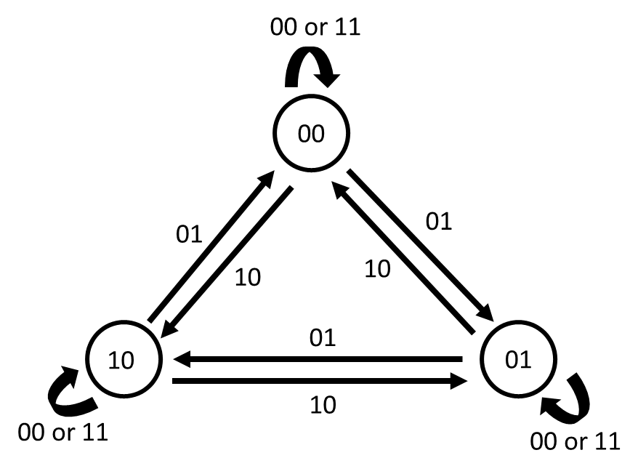
D flip-flop state machine
Example 3:
Create a state-machine using 2 D flip-flops that follows the below state diagram

Slide 24
D flip-flop state machine
Do step 1, step 2 and step 3 as mentioned above in Example 1
Present state |  |  |  | Next State |  | D inputs
Q₁ | Q₀ | X | Y | Q₁ | Q₀ | D₁ | D₀
0 | 0 | 0 | 0 | 0 | 0 | 0 | 0
0 | 0 | 0 | 1 | 0 | 1 | 0 | 1
0 | 0 | 1 | 0 | 1 | 0 | 1 | 0
0 | 0 | 1 | 1 | 0 | 0 | 0 | 0
0 | 1 | 0 | 0 | 0 | 1 | 0 | 1
0 | 1 | 0 | 1 | 1 | 0 | 1 | 0
0 | 1 | 1 | 0 | 0 | 0 | 0 | 0
0 | 1 | 1 | 1 | 0 | 1 | 0 | 1
1 | 0 | 0 | 0 | 1 | 0 | 1 | 0
1 | 0 | 0 | 1 | 0 | 0 | 0 | 0
1 | 0 | 1 | 0 | 0 | 1 | 0 | 1
1 | 0 | 1 | 1 | 1 | 0 | 1 | 0

Slide 25
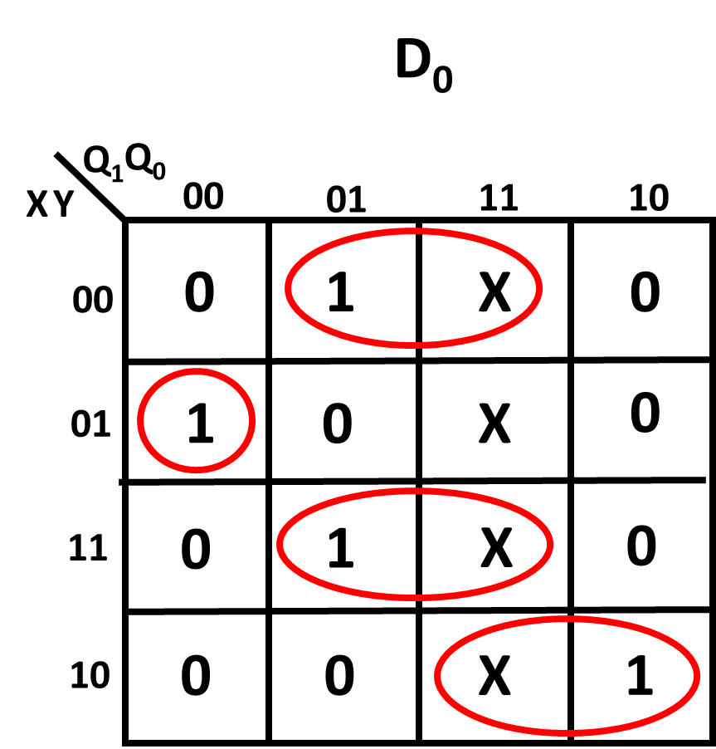
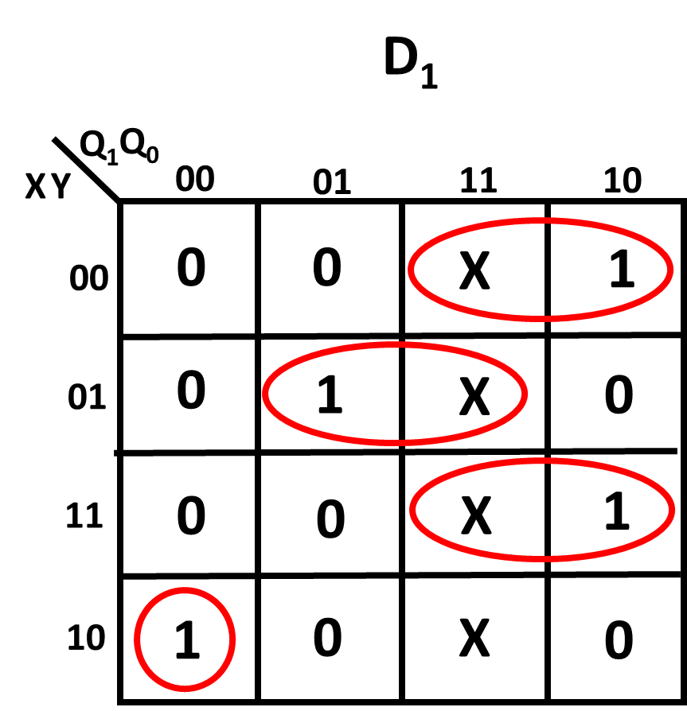


Step 4 Create 2 K-map for D₁ and D₀ whose inputs are the present states of Q₁ and Q₀ together with inputs X and Y
Table we had created
Present state |  |  |  | Next State |  | D inputs
Q₁ | Q₀ | X | Y | Q₁ | Q₀ | D₁ | D₀
0 | 0 | 0 | 0 | 0 | 0 | 0 | 0
0 | 0 | 0 | 1 | 0 | 1 | 0 | 1
0 | 0 | 1 | 0 | 1 | 0 | 1 | 0
0 | 0 | 1 | 1 | 0 | 0 | 0 | 0
0 | 1 | 0 | 0 | 0 | 1 | 0 | 1
0 | 1 | 0 | 1 | 1 | 0 | 1 | 0
0 | 1 | 1 | 0 | 0 | 0 | 0 | 0
0 | 1 | 1 | 1 | 0 | 1 | 0 | 1
1 | 0 | 0 | 0 | 1 | 0 | 1 | 0
1 | 0 | 0 | 1 | 0 | 0 | 0 | 0
1 | 0 | 1 | 0 | 0 | 1 | 0 | 1
1 | 0 | 1 | 1 | 1 | 0 | 1 | 0
D₀ = Q₀ $\overline{X}\overline{Y}$ + Q₀XY + Q₁X$\overline{Y}$ + $\overline{Q}$₁$\overline{Q}$₀ $\overline{X}$Y
D₁ = Q₀$\overline{X}$Y + Q₁$\overline{X}\overline{Y}$ + Q₁XY + $\overline{Q}$₁ $\overline{Q}$₀X$\overline{Y}$

Slide 26
Multiplexer , Comparators and De-Multiplexer

Slide 27
Multiplexer , Comparators and De-Multiplexer
What is a Multiplexer A Multiplexer takes its input and feed it to a respective output depending on the binary combination on its address inputs
What is a Comparator A Comparator compares the Binary values of 2 inputs and determine if one of its input is greater, smaller or equal to the other input. What is a De-Multiplexer A De-multiplexer will allow one input signal from its list of inputs to cross to its Output depending on the binary combination of address inputs.

Slide 28
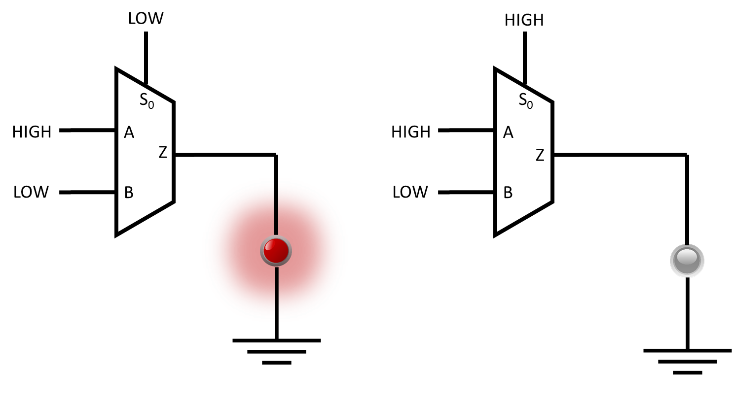
Multiplexer , Comparators and De-Multiplexer
Multiplexer
When S₀ is Low, input A is selected hence the bulb light up as the signal from A is able to pass to Z
When S₀ is High, input B is selected hence the bulb did not light up as the signal from B going to Z does not have a Logic high.
Truth Table
S₀ | Z
0 | Input A
1 | Input B

Slide 29
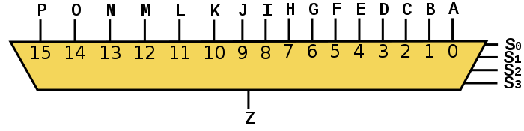
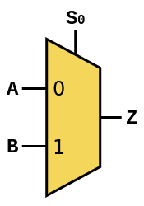
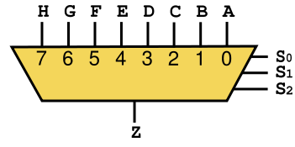
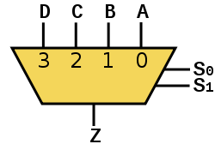
Multiplexer , Comparators and De-Multiplexer
Example of Multiplexers
2x1 MUX
4x1 MUX
8x1 MUX
16x1 MUX

Slide 30
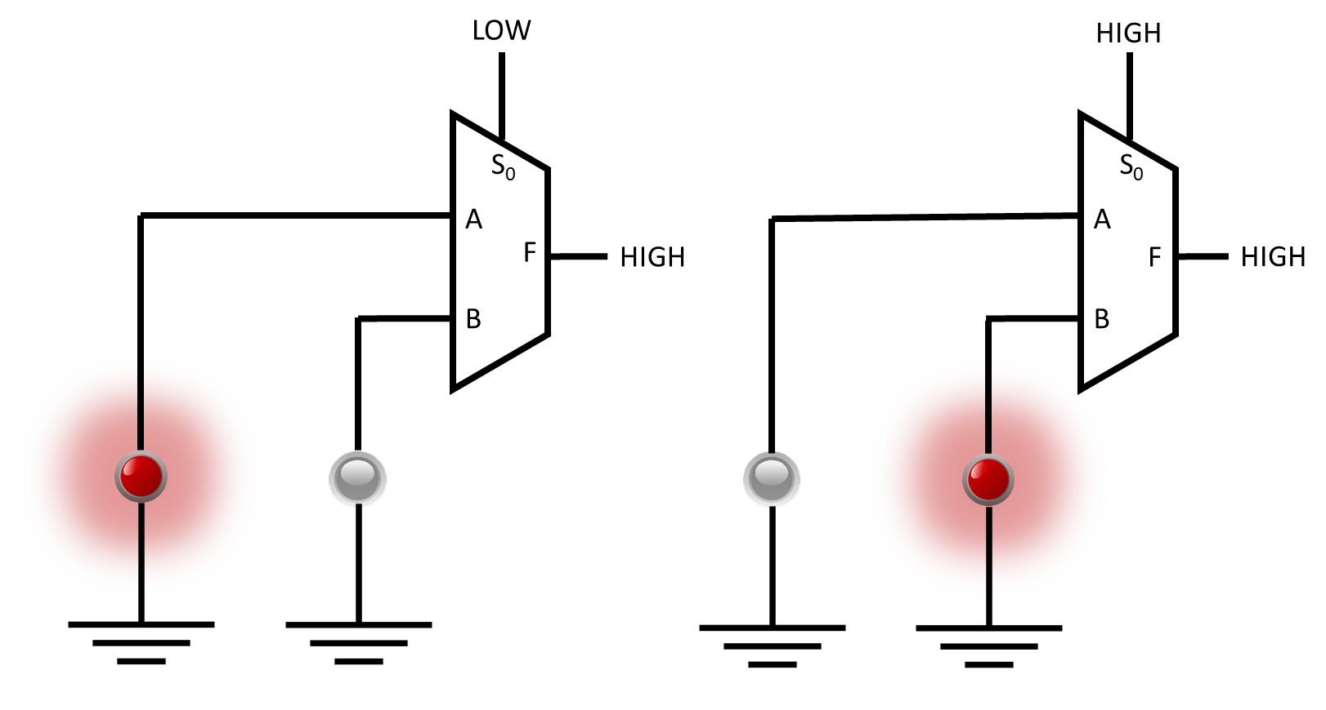
Multiplexer , Comparators and De-Multiplexer
De-Multiplexer
When S₀ is Low, Output A is selected hence the bulb connected to Output A light up as the signal from F is able to travel to Output A
When S₀ is High, Output B is selected hence the bulb connected to Output B light up as the signal from F now able to travel to Output B instead of Output A
Truth Table
Input | Output
S₀ | A | B
0 | F | 0
1 | 0 | F

Slide 31
Multiplexer , Comparators and De-Multiplexer
Example of De-Multiplexers
Some Multiplexer allow you to connect Z as the input and all the respective MUX inputs as outputs to create a De-Multiplexer.
1x2 DEMUX
1x4 DEMUX
1x8 DEMUX
1x16 DEMUX

Slide 32
Multiplexer , Comparators and De-Multiplexer
Multiplexer and De-Multiplexer Flash Amination

Slide 33
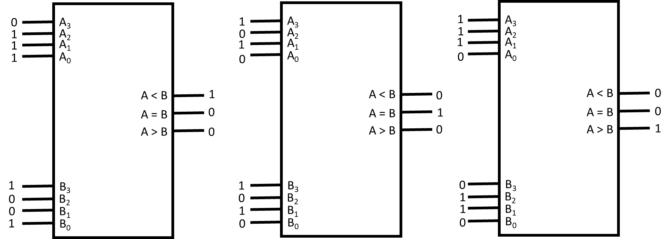
Multiplexer , Comparators and De-Multiplexer
Comparator Below shows a comparator comparing the input values of A and B. There are 3 conditions that the comparator will output which is A > B, A = B or A < B
A smaller than B
A is equal to B
A is bigger than B

Slide 34
Encoder, Decoder and counters

Slide 35
Encoder, Decoder and counters
What is a Encoder An Encoder take a signal and changes it signal to another format before sending it out to other circuits. What is a Decoder An Decoder takes the signal it receives and change its representation back to its original format before signal was encoded. What is a Counter A counter is a Electronics circuit that counts from value A to value B. When the counter has reach value B, the count will reset back to value A

Slide 36
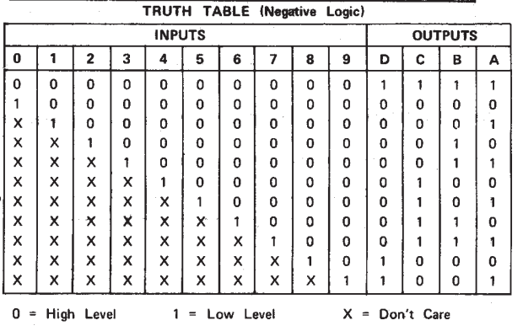
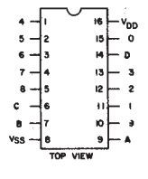
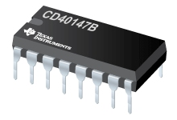
Encoder, Decoder and counters
Example of Encoder
40147 encoder:
The 40147 encoder AKA 10-line to 4-line (BCD) priority encoder takes Decade inputs and convert it into BCD.

Slide 37
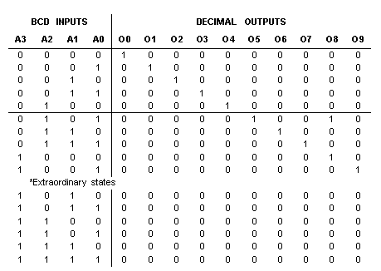
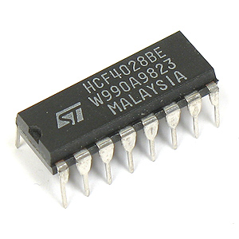
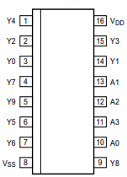
Encoder, Decoder and counters
Example of Decoder
4028 decoder:
The 4028 decoder takes the BCD inputs and output a HIGH correspond to the respective value from 0 to 9 the pins represent

Slide 38
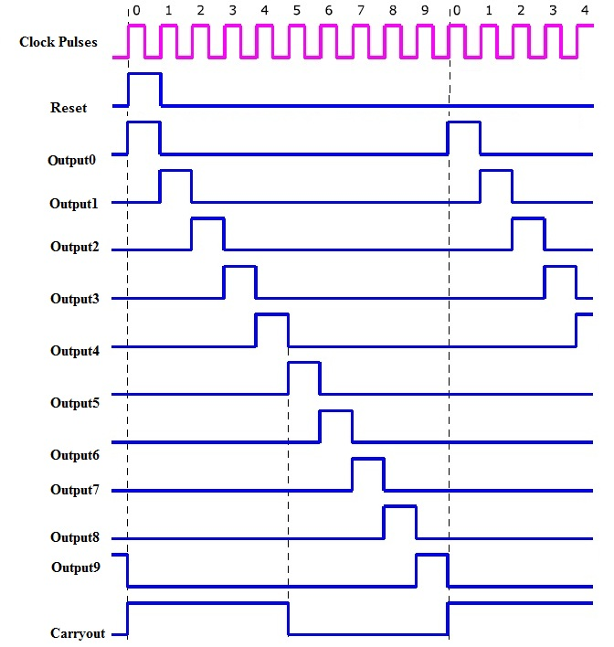
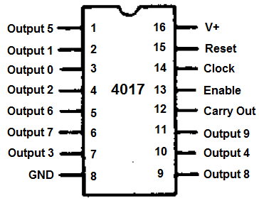
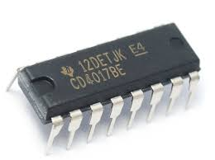
Encoder, Decoder and counters
Examples of counters
4017 Decade counter/ Johnson counter
The Decade counter will count from 0 to 9 than back again to 0. Each clock pulse will make the 4017 counter change count
http://www.falstad.com/circuit/e-johnsonctr.html

Slide 39
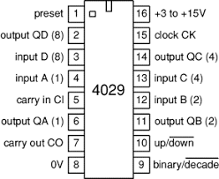
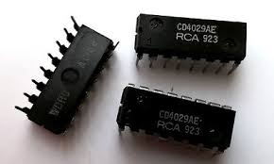
Encoder, Decoder and counters
Examples of counters
4029 - up/down synchronous counter
The 4029 counter is an Binary/BCD counters which can count up or count down.
Each clock pulse will make the counter change count
http://www.falstad.com/circuit/e-synccounter.html

Slide 40
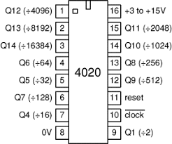
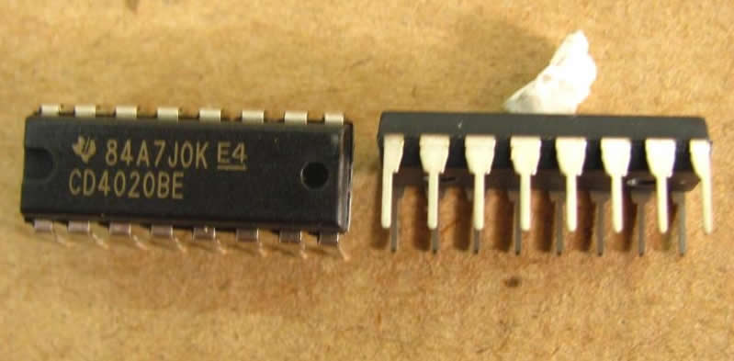
Encoder, Decoder and counters
Examples of counters
4020 - 14-bit (÷16,384) ripper counter
Ripper counters are devices that decrease the frequency of the clock pulse
The 4020 ripper counters can reduce the clock frequency by 2, 16, 32, 64, 128, 512, 256, 1024, 2048, 4096, 8192 and 16384 times
http://www.falstad.com/circuit/e-counter.html

Slide 41
7-Segment display, 7-Segment display decade counter and BCD to 7-segment display driver

Slide 42
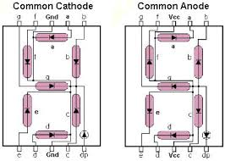
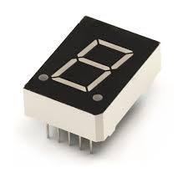
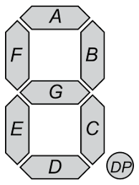
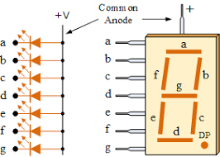
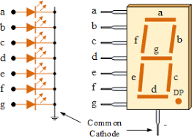
7-Segment display, 7-Segment display decade counter and BCD to 7-segment display driver
7-Segment display
A 7-segment display consist of 7 LED connected in such a way to display a decimal digit
There are 2 types of 7-segment display Common Cathode and Common Anode.

Slide 43
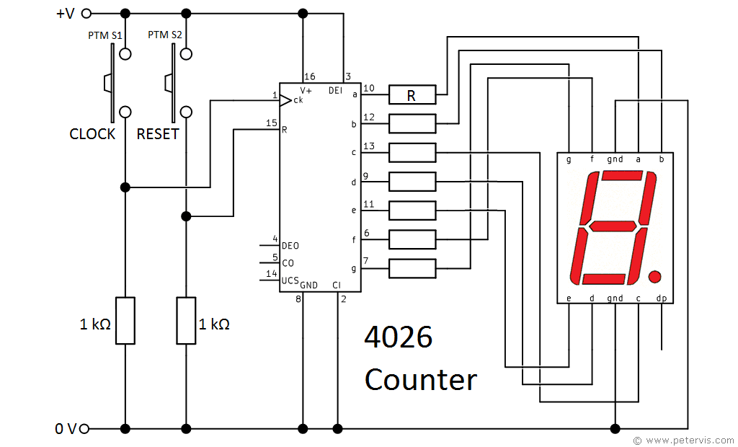


7-Segment display, 7-Segment display decade counter and BCD to 7-segment display driver
7-Segment display decade counter
The 4026 decade counter for 7-Segment display counts from 0 to 9 than back to 0 again.
The 4026 decade counter is use for common cathode 7-segment display only
4026 connected to a common cathode 7-segment display

Slide 44



7-Segment display, 7-Segment display decade counter and BCD to 7-segment display driver
BCD to 7-segment display driver
The 4511 is a BCD to 7-segment display decoder that decode binary value from 0000₂ to 1001₂ to display the respective output on the 7-Segment display 4511 is use to drive common cathode 7-segment display
http://www.falstad.com/circuit/e-7segdecoder.html
4511 decoder connected to a common cathode 7-segment display

Slide 45
The END

